Slide 1
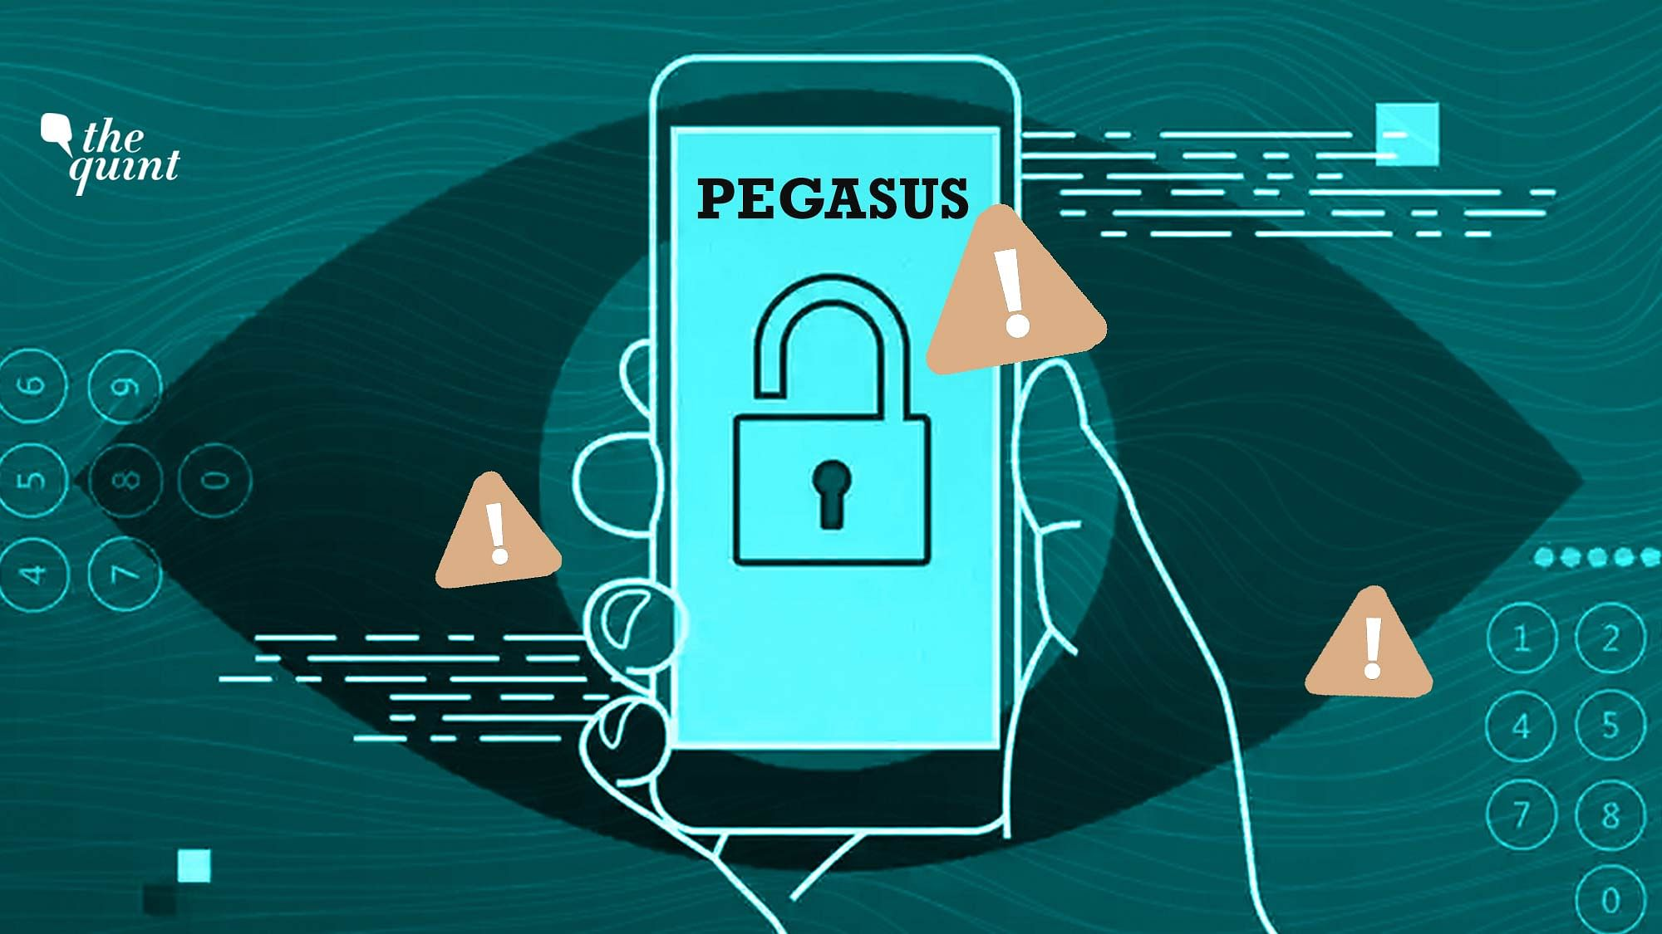
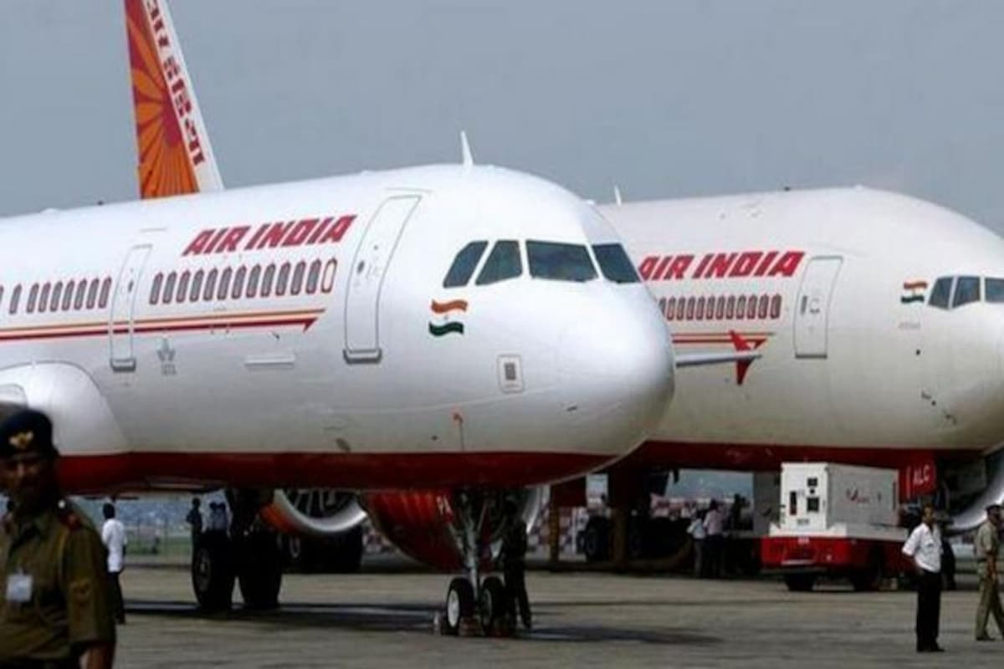
2 CASE STUDIES OF RECENT HACKS
PRESIDENT BY :- SOUMIK MUKHERJEE
Air India cyber attack 2021
Pegasus spyware attack

Slide 2
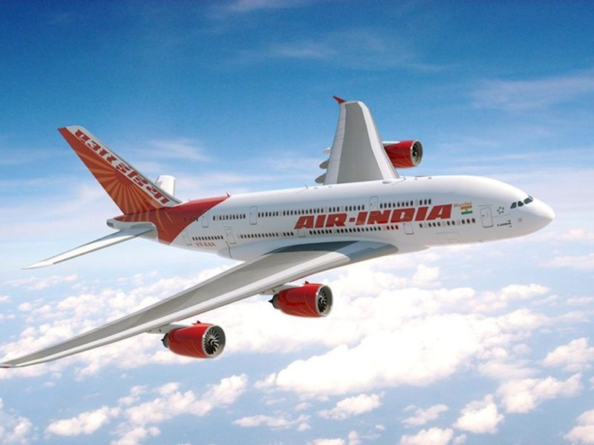
AIR INDIA CYBER ATTACK
On 21st may 2021, it was reported that Air India was subjected to a cyberattack whereas the personal details of about 4.5 million customers around the world were compromised including their passport, date of birth, credit card details and ticket information.
Actually cyberattack not happened to air india directly, Air India’s data processor , SITA which is situated in Geneva,Switzerland , a tetechnology company which is also known for offering passenger service system provider reported this data breach to air india in around feburary 2021.
The breach involved personal data registered between 26th august 2011 to 20th february 2021. SITA also revealed that the cyberattackers gain the aaccess to the system for a periods of 22 days.
Cyberattackers are unknown to everybody till this date.
Air India airline ,while admitting that the details of credit card also have been breached but they also clarified that the CVV numbers – which is the key to execute transactions were not held by its data processor.
Also password data were not affected.
The airline said they Secured the compromised servers, engaged external specialists of data security incidents and also notified their frequent flyer to reset the credit card password.

Slide 3
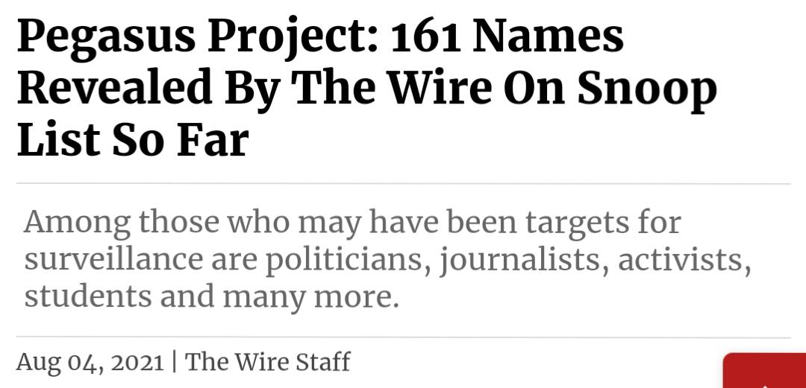

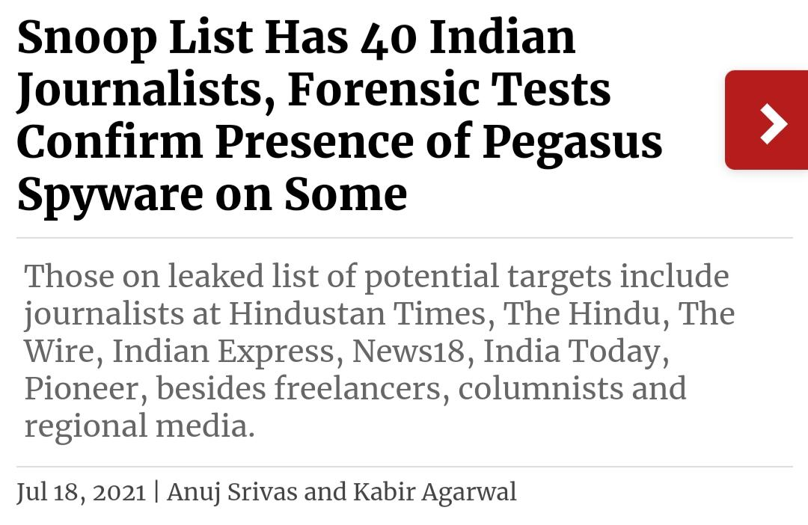
PEGASUS SPYWARE ATTACK
What is PEGASUS -
It is a type of malicious software or malware classified as a spyware , it has been developed by the Israeli firm NSO group.
This is designed to gain access to suspects device without their knowledge and gather all personal details of that suspect and forward everything to that person who is spying on you. It can spy android and iOS both.
What happened -
According to a report which published on 18th july 2021 ,of India’s nonprofit and opinion website THE WIRE ,phones of two union ministers, three opposite leaders, one constitutional authority , current and former heads of security organizations administrators and 40 senior journalists and activists from India were attacked by PEGASUS and put on surveillance.
NSO did not openly name anyone behind this attack but they said that their products are use by government intelligence and law enforcement agencies to fight crime and terror.

Slide 4
Thank you

